Slide 1


FAKE NEWS CLASSIFIER
Pinky Chauhan
University of Illinois at Urbana-Champaign

Slide 2
Overview/Objective
Build a classifier system based on machine learning
Able to identify fake news from real/reliable news given a news title/text as input
Can be integrated with social media platforms to flag/filter out potentially fake articles
RELIABLE NEWS
CLASSIFIER
NEWS (TITLE, TEXT)
FAKE NEWS

Slide 3
Why Fake News Classifier?
Increasingly prevalent
Widespread on social media and websites
Hard to distinguish
Similar tone/style as reliable news
Hard for human eye to catch differences
Machine learning can help

Slide 4
Technology/Libraries
Language/Tools
Python 3
Jupyter Notebook
Python/Machine Learning libraries
NLTK (Natural Language ToolKit)
SkLearn (Machine Learning)
Pandas (Data Analysis)
Matplotlib (Plotting data as graphs)
Joblib (Export and load trained model)
Re (Regular expression utility)
Itertools (Iteration utility)

Slide 5
Dataset
https://www.kaggle.com/c/fake-news/data
train.csv: A full training dataset with the following attributes:
id: unique id for a news article
title: the title of a news article
author: author of the news article
text: the text of the article; could be incomplete
label: a label that marks the article as potentially unreliable
1: unreliable/fake
0: reliable
test.csv: A testing training dataset with all the same attributes at train.csv without the label.
submit.csv: A sample submission to be populated with predictions of classifier on test.csv

Slide 6
Code Structure

Slide 7
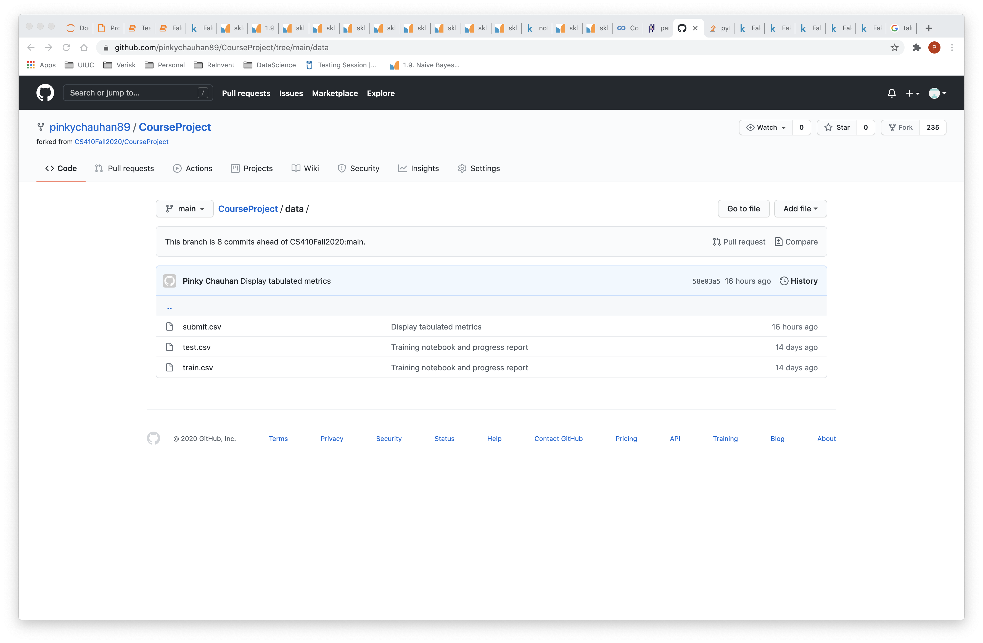

Slide 8
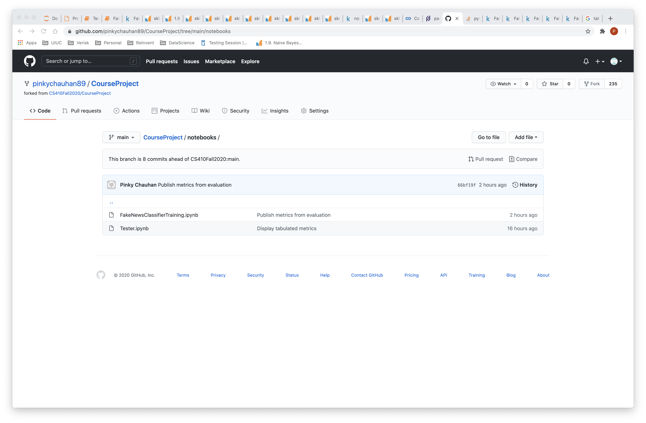

Slide 9
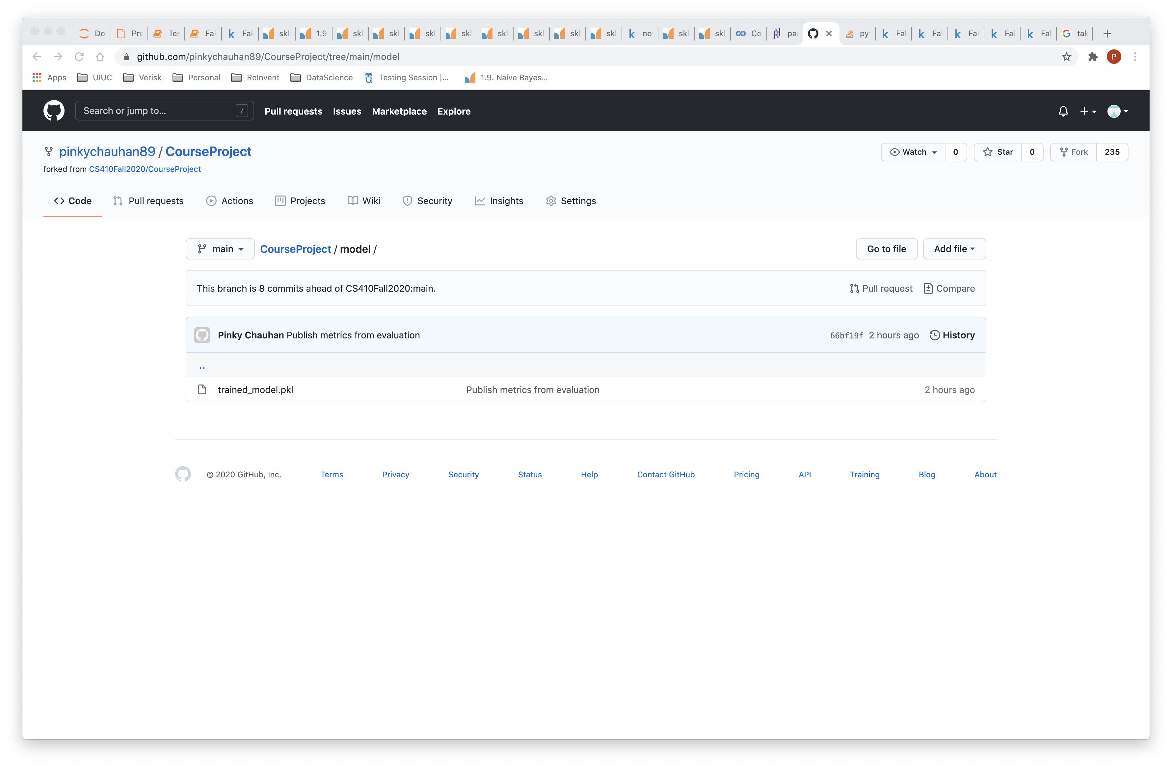

Slide 10
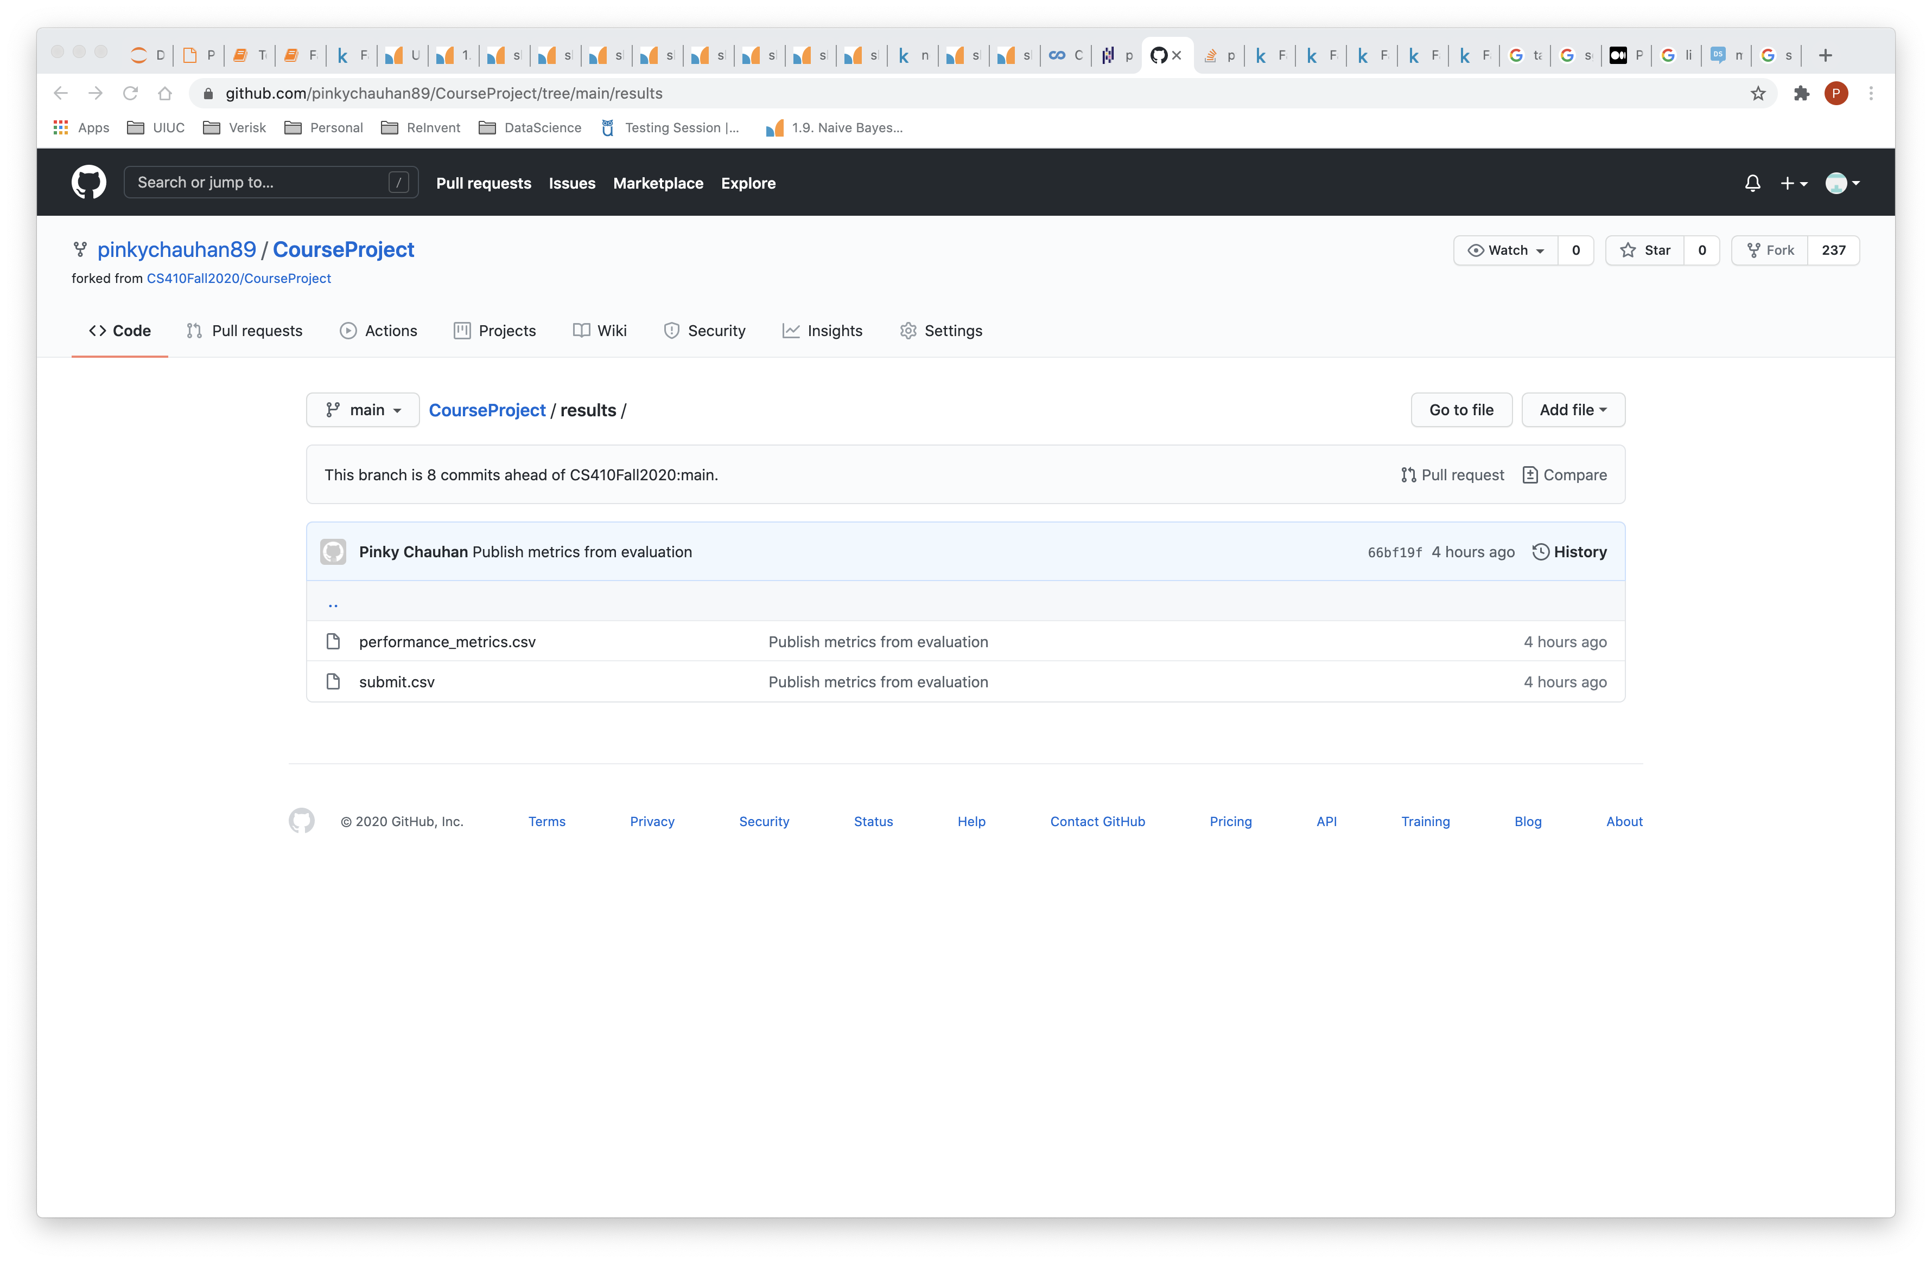

Slide 11
Execution
Data analysis
Preprocessing
Feature Extraction
Vectorization
Model training and tuning
Performance assessment

Slide 12
Data Analysis
Data distribution (Real vs fake labels)
Attributes contribution towards category
Author’s distribution
Polarity/Sentiment Analysis

Slide 13
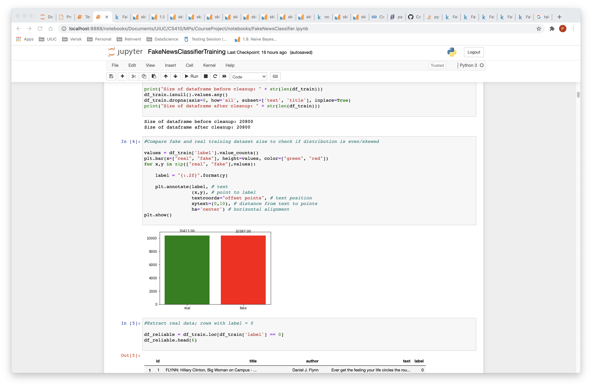

Slide 14
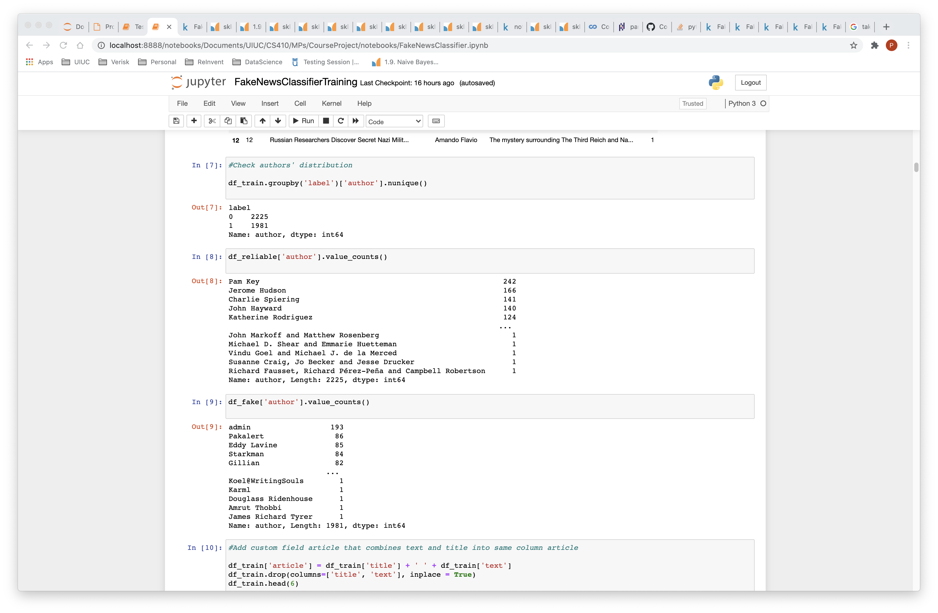

Slide 15
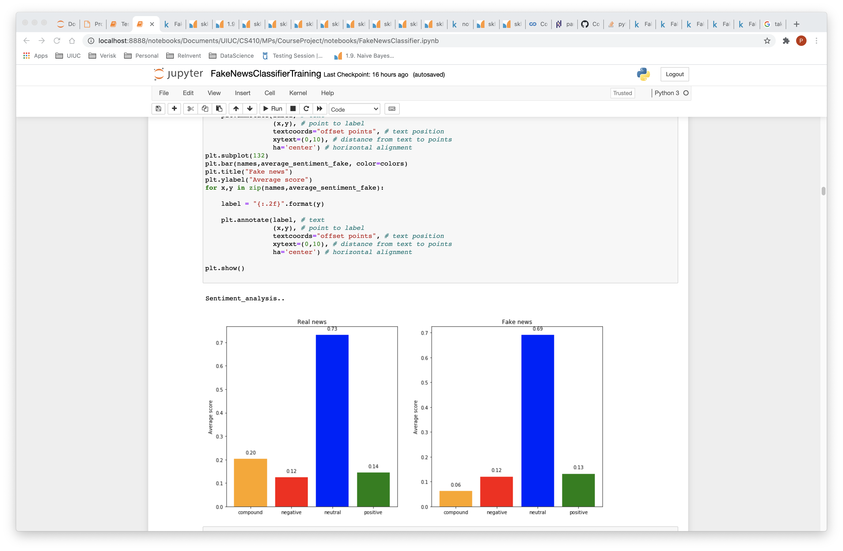

Slide 16
Preprocessing
Remove any rows with text and title both missing
Remove any punctuations, Convert to lower case
Tokenization into bag-of-words
Stop words and small words removal
Lemmatization

Slide 17
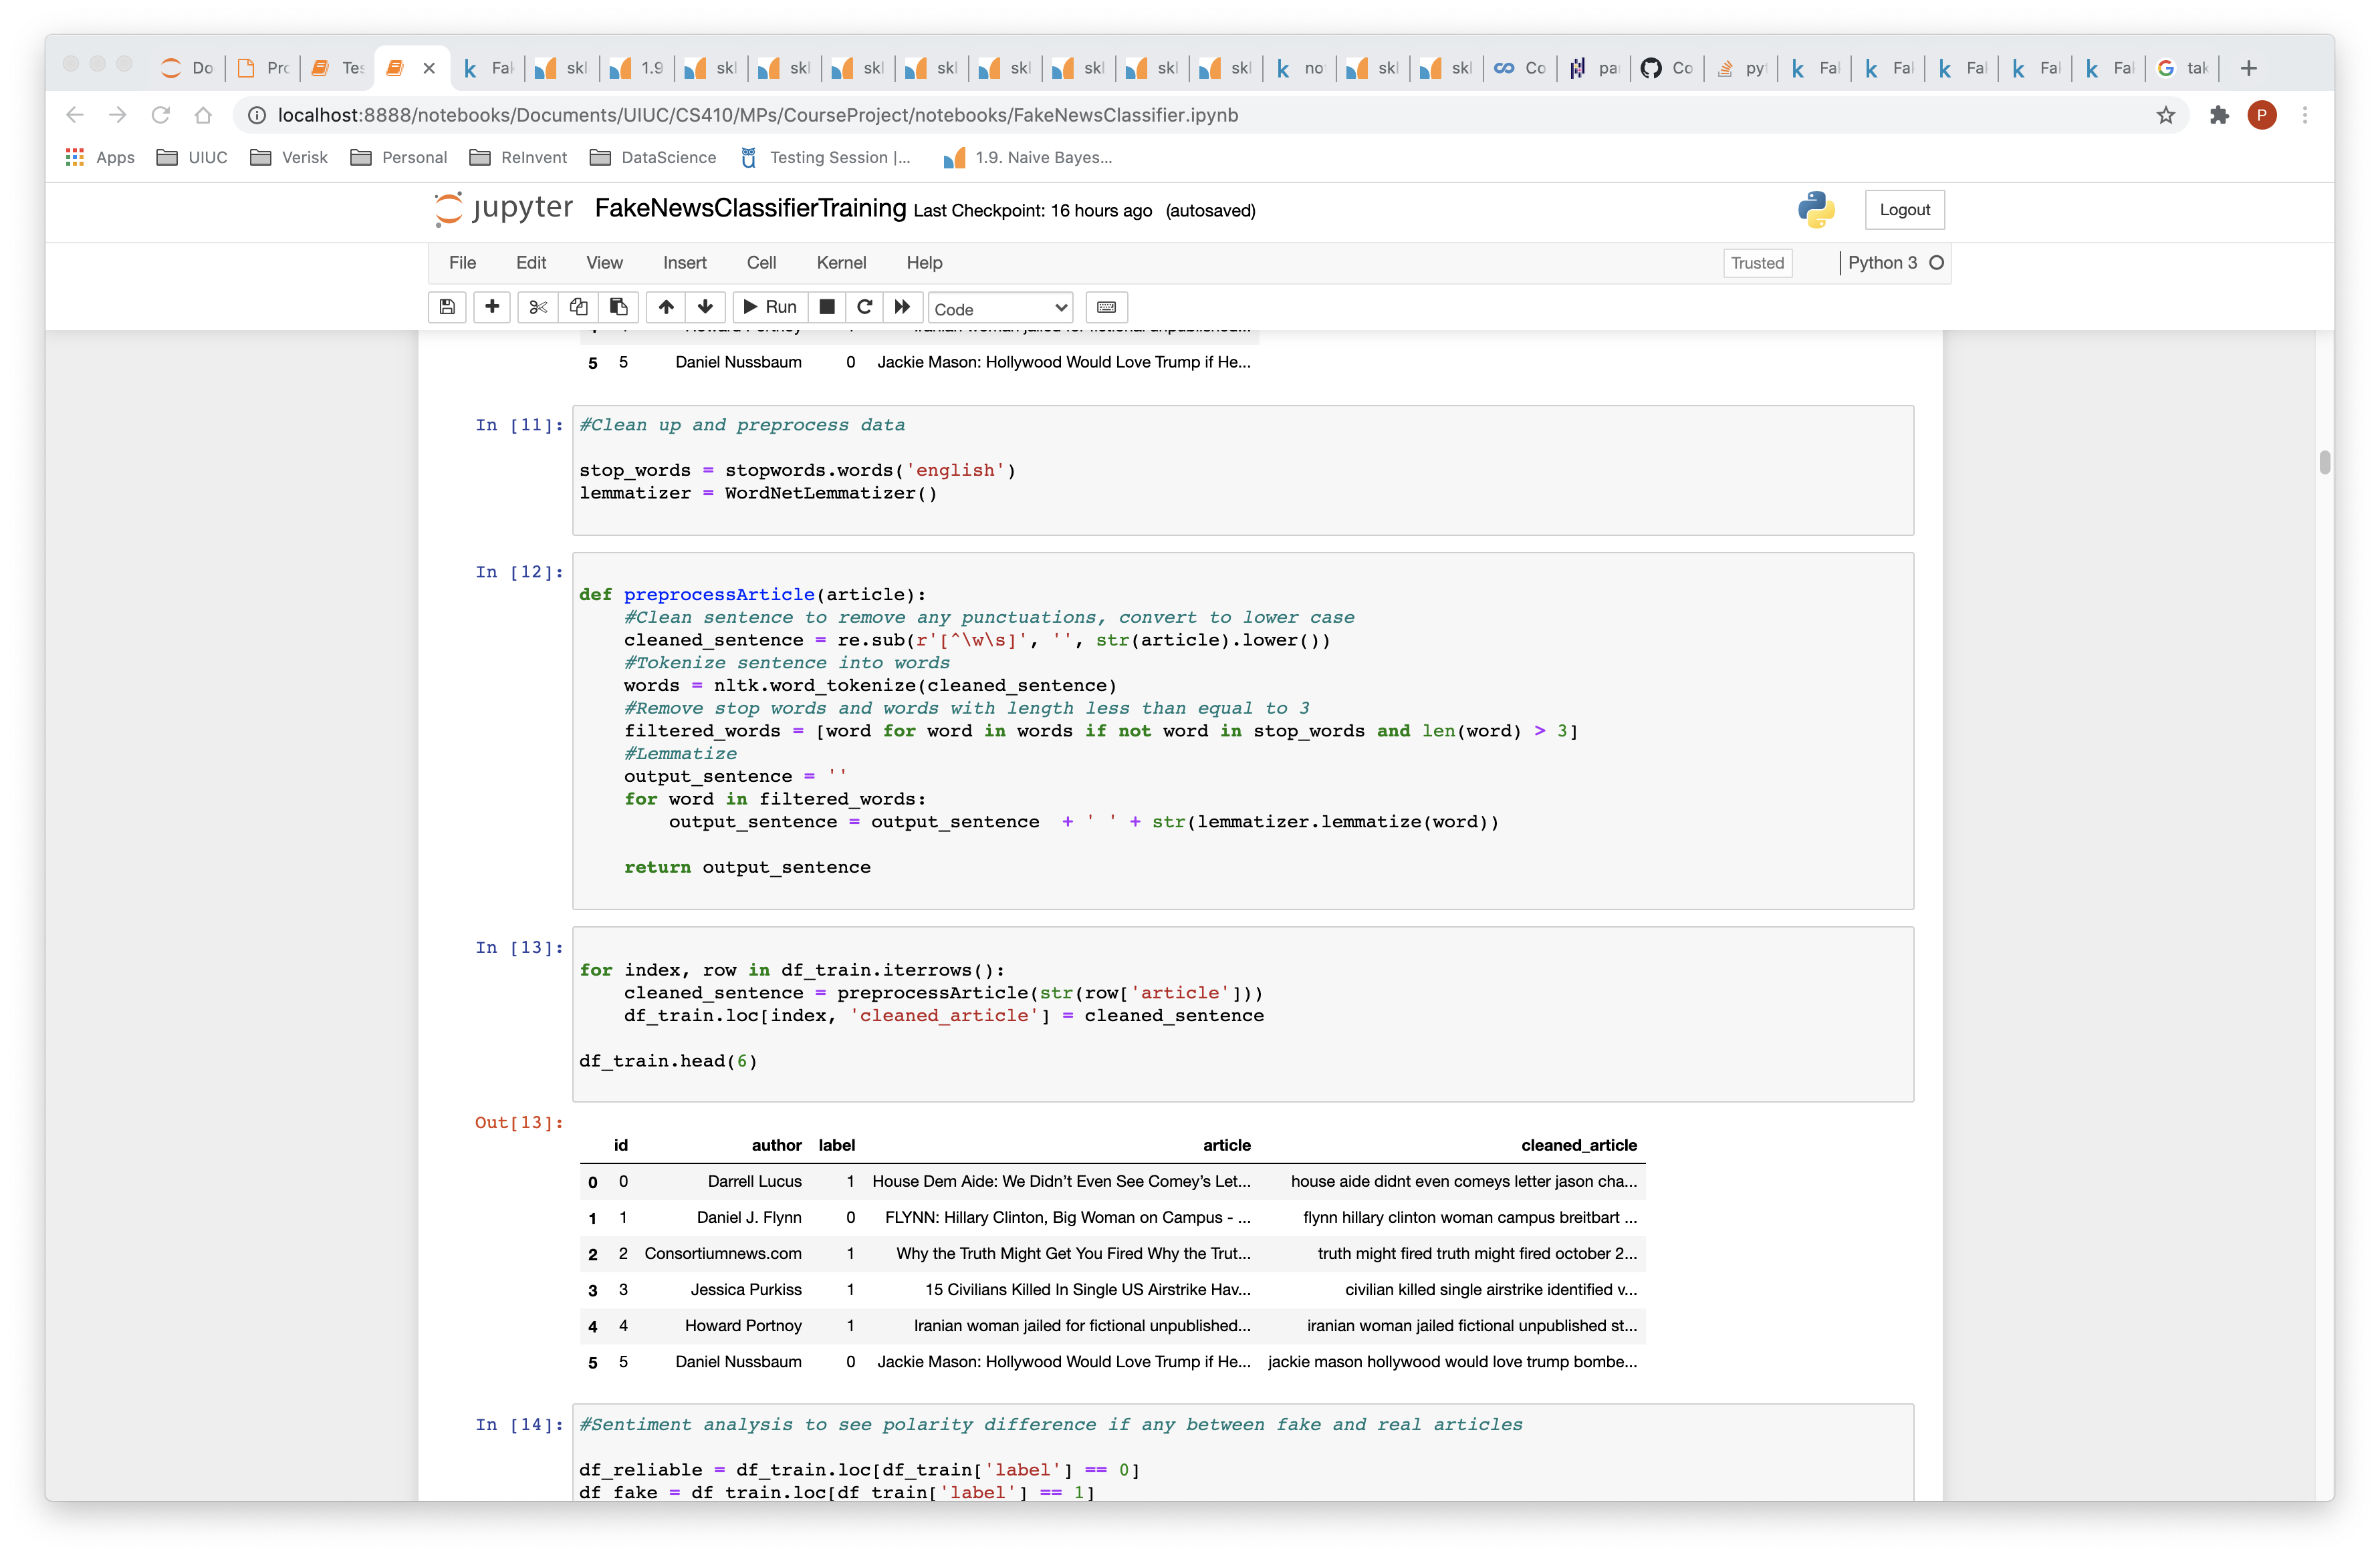

Slide 18
Feature Extraction
Cleaned article (title + text) used as feature

Slide 19
Vectorization
Term frequency (TF) based vector over unigrams
Term frequency (TF) based vector over unigrams and bigrams
Term frequency/inverse document frequency (TF-IDF) based vector over unigrams
TF-IDF based vector over unigrams and bigrams
TF-IDF based vector over unigrams, bigrams and trigrams

Slide 20
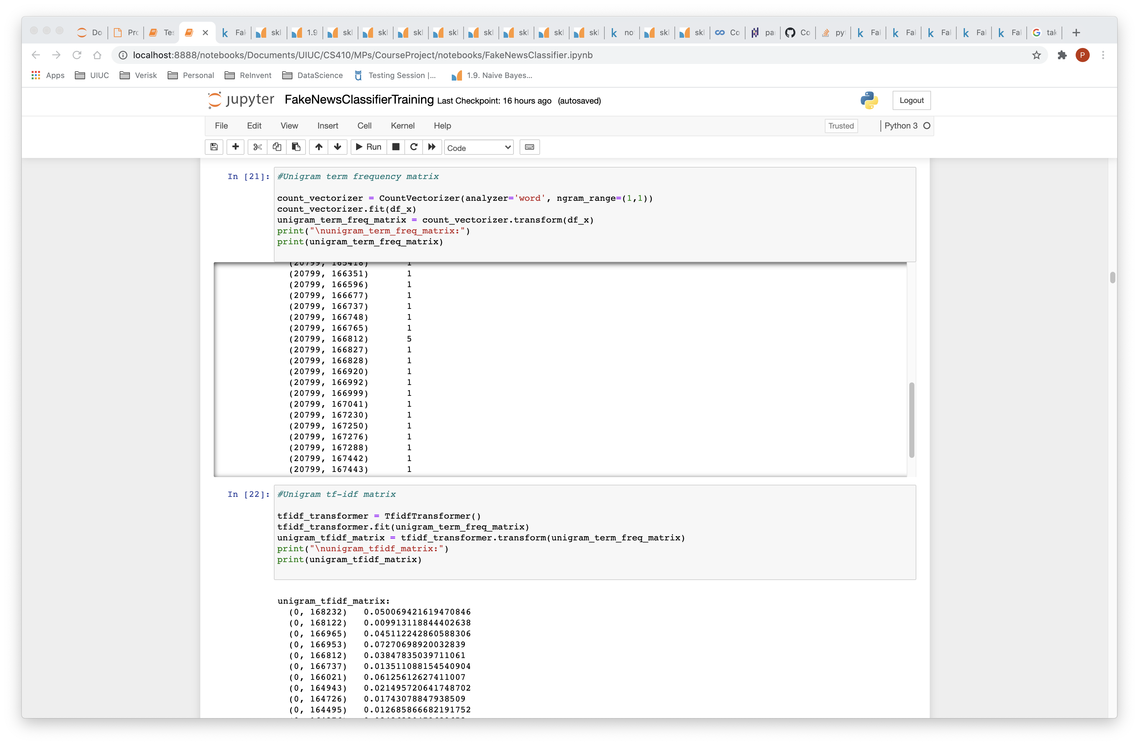

Slide 21
Model Training & Tuning
Naïve bayes (Multinomial)
Logistic Regression
SVM using Linear SVC
SGDC classifier
Decision Tree

Slide 22
Naïve Bayes (Multinomial)
Probabilistic classifier inspired by the Bayes theorem under a simple assumption that attributes are conditionally independent
Training with smoothing
Without smoothing
Unigrams/Bi-grams/Trigrams term frequency vectorizer
Unigrams/Bi-grams/Trigrams term frequency/inverse documents frequency vectorizer

Slide 23
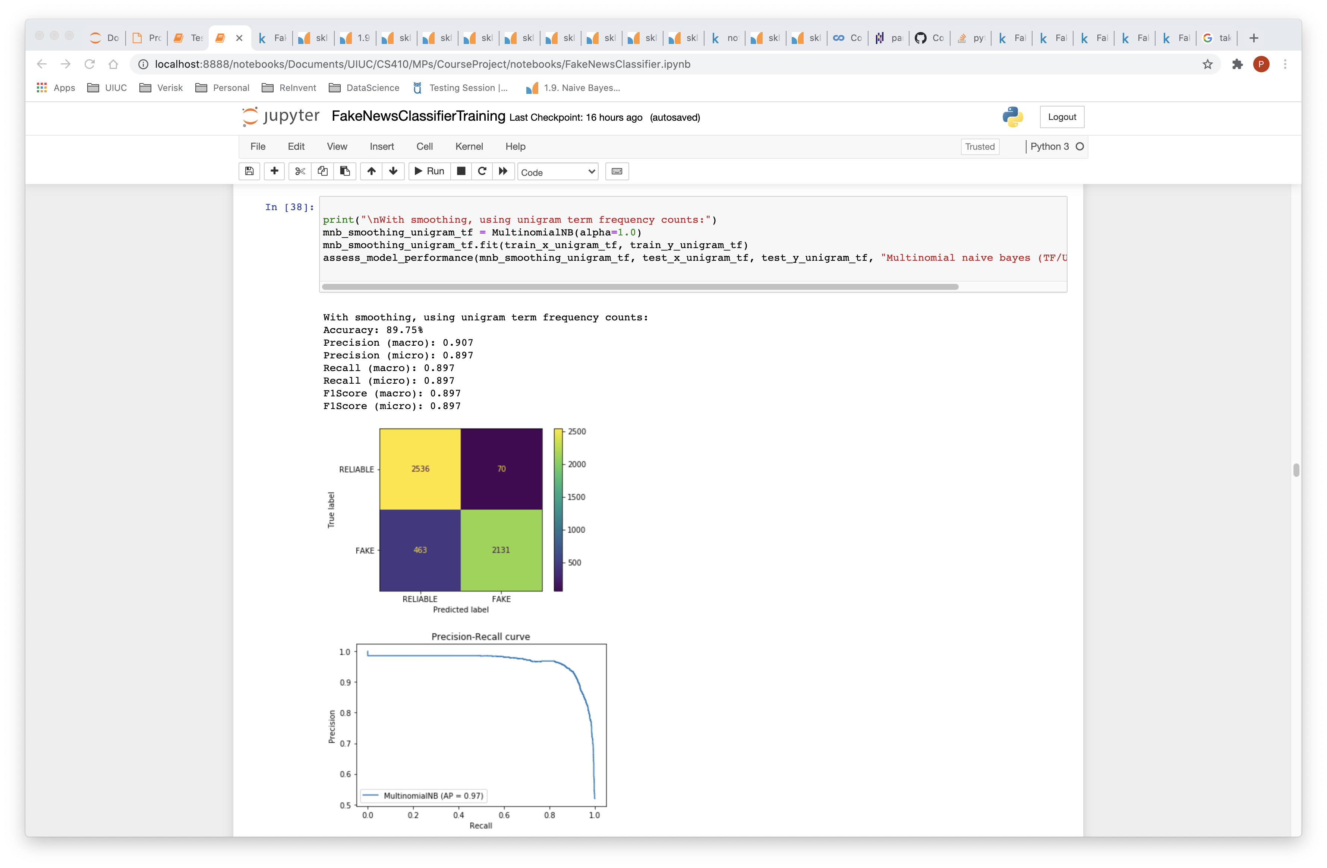

Slide 24
Logistic Regression
Uses a logistic function to model a binary dependent variable
Used when dependent variable is binary in nature
Unigrams/Bi-grams/Trigrams term frequency/inverse documents frequency vectorizer

Slide 25
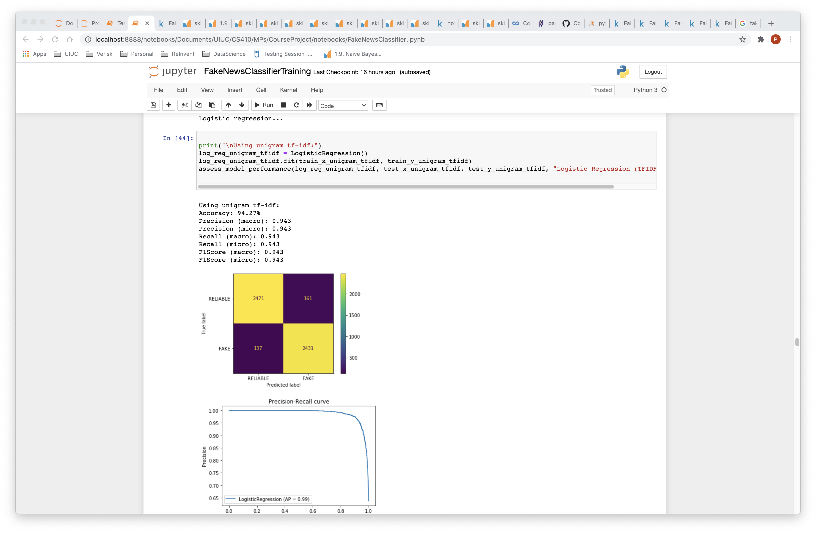

Slide 26
Support Vector Machines (Linear SVC)
Fit to the data, returning a "best fit" hyperplane that divides, or categorizes data
LinearSVC only supports a linear kernel, is faster and can scale a lot better
Unigrams/Bi-grams/Trigrams term frequency/inverse documents frequency vectorizer
Tuning regularization

Slide 27
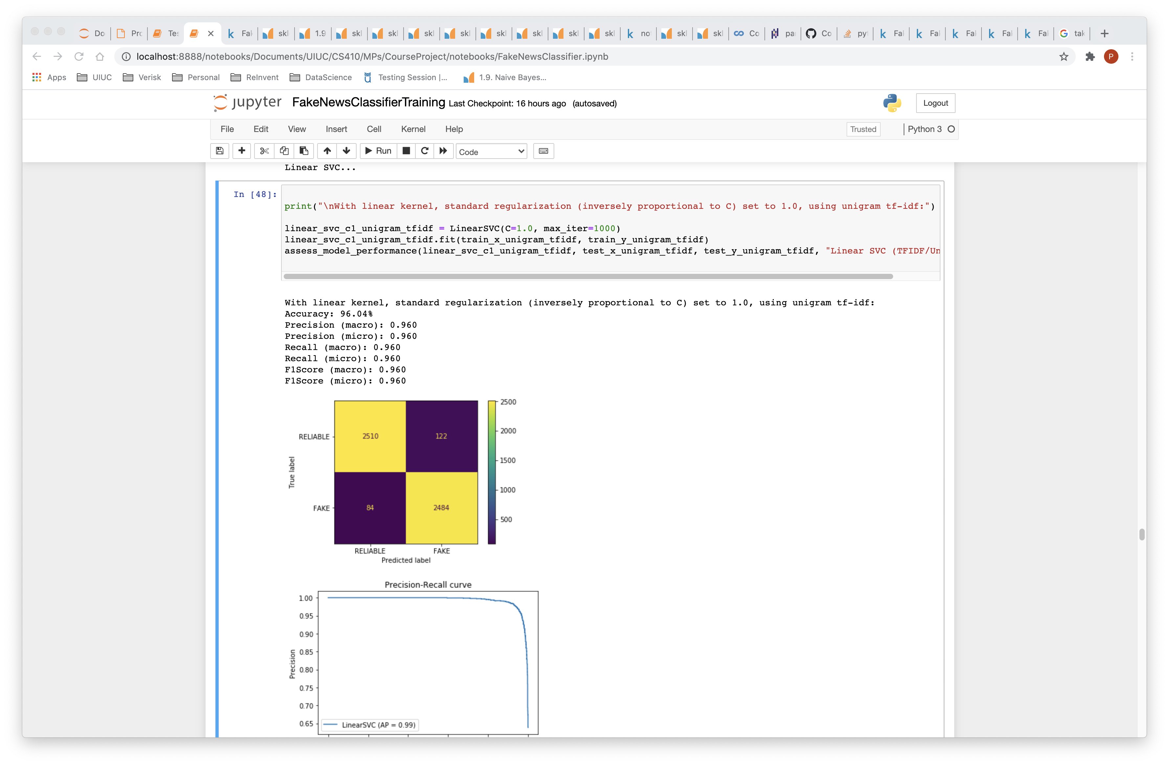

Slide 28
SGDC (Stochastic gradient descent Classifier)
Linear classifier optimized by the Stochastic gradient descent (SGD)
Faster convergence
Looking for the minima of the loss using SGD
Unigrams/Bi-grams/Trigrams term frequency/inverse documents frequency vectorizer

Slide 29
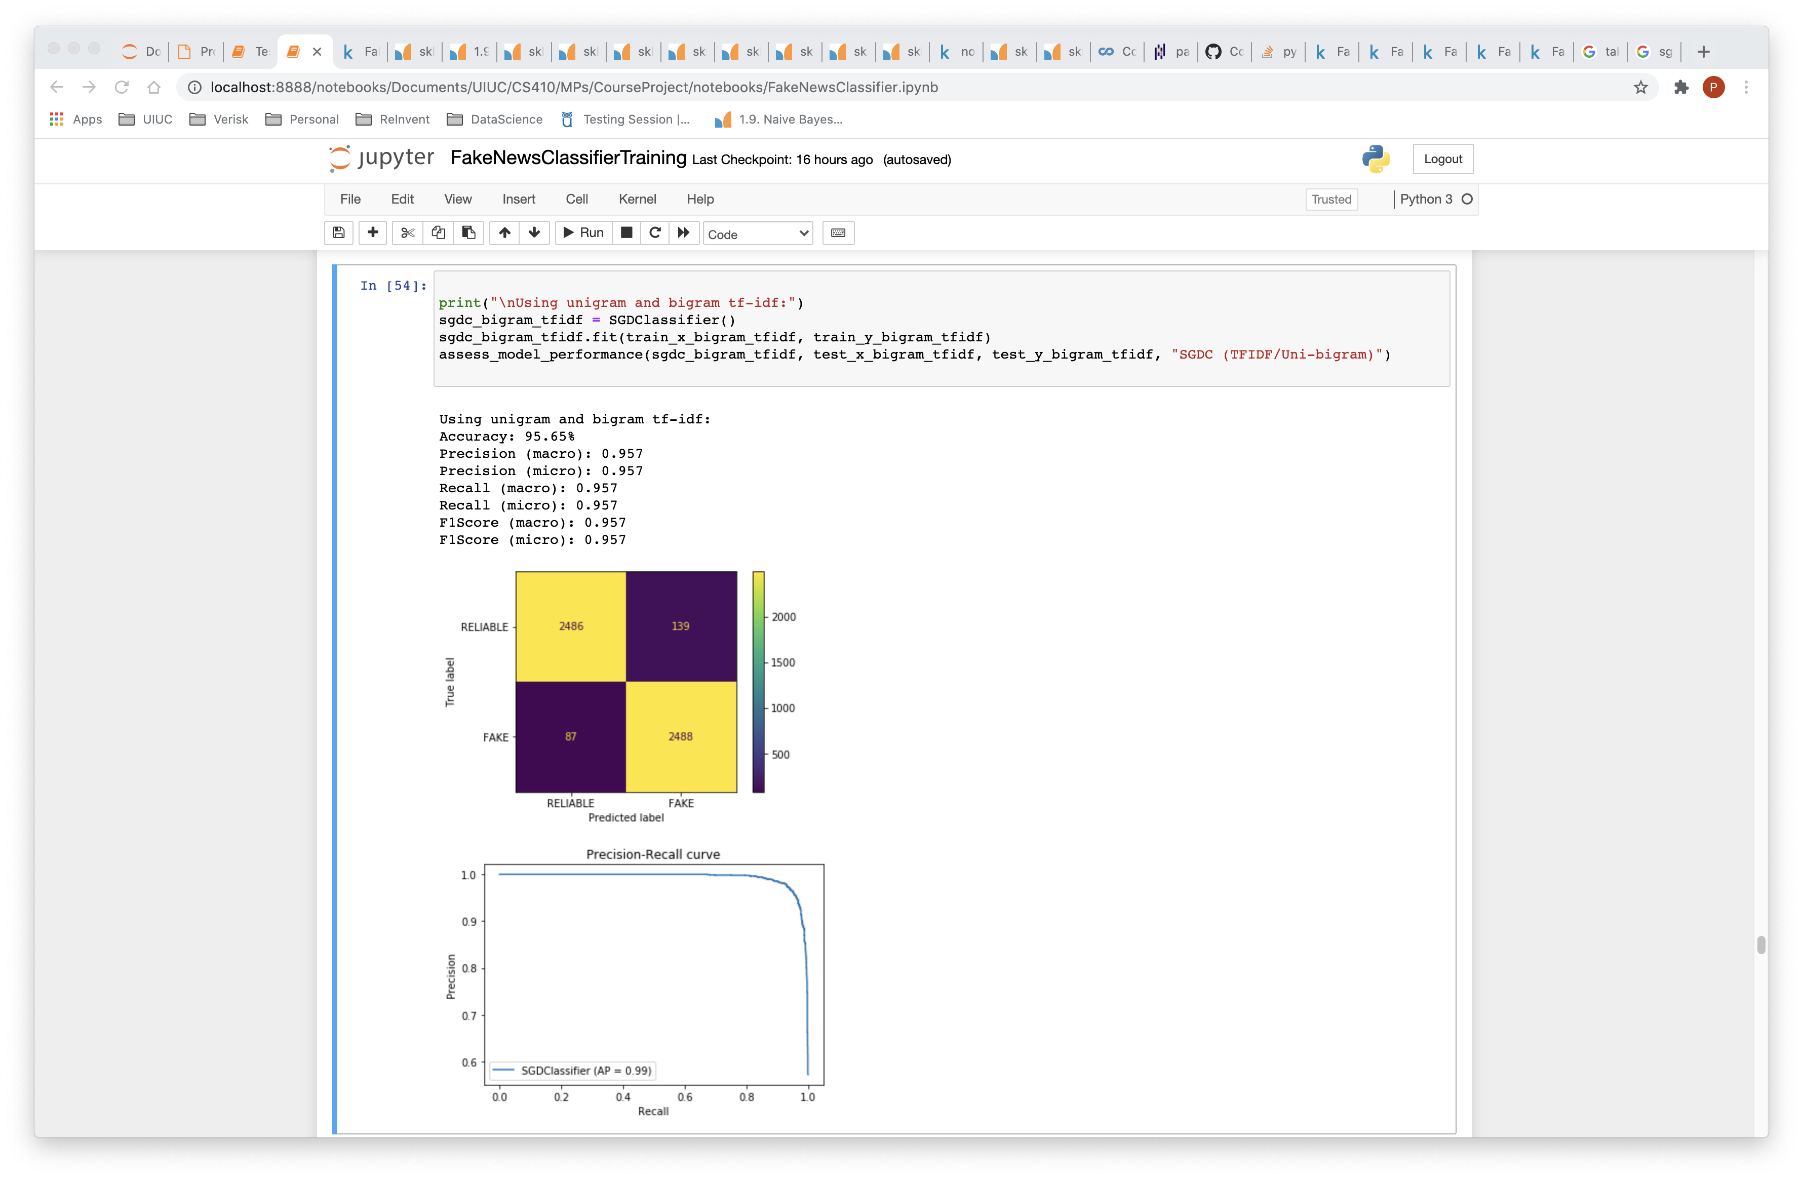

Slide 30
Decision Tree
Builds classification or regression models in the form of a tree structure
Utilizes an if-then rule
Unigrams/Bi-grams/Trigrams term frequency/inverse documents frequency vectorizer

Slide 31
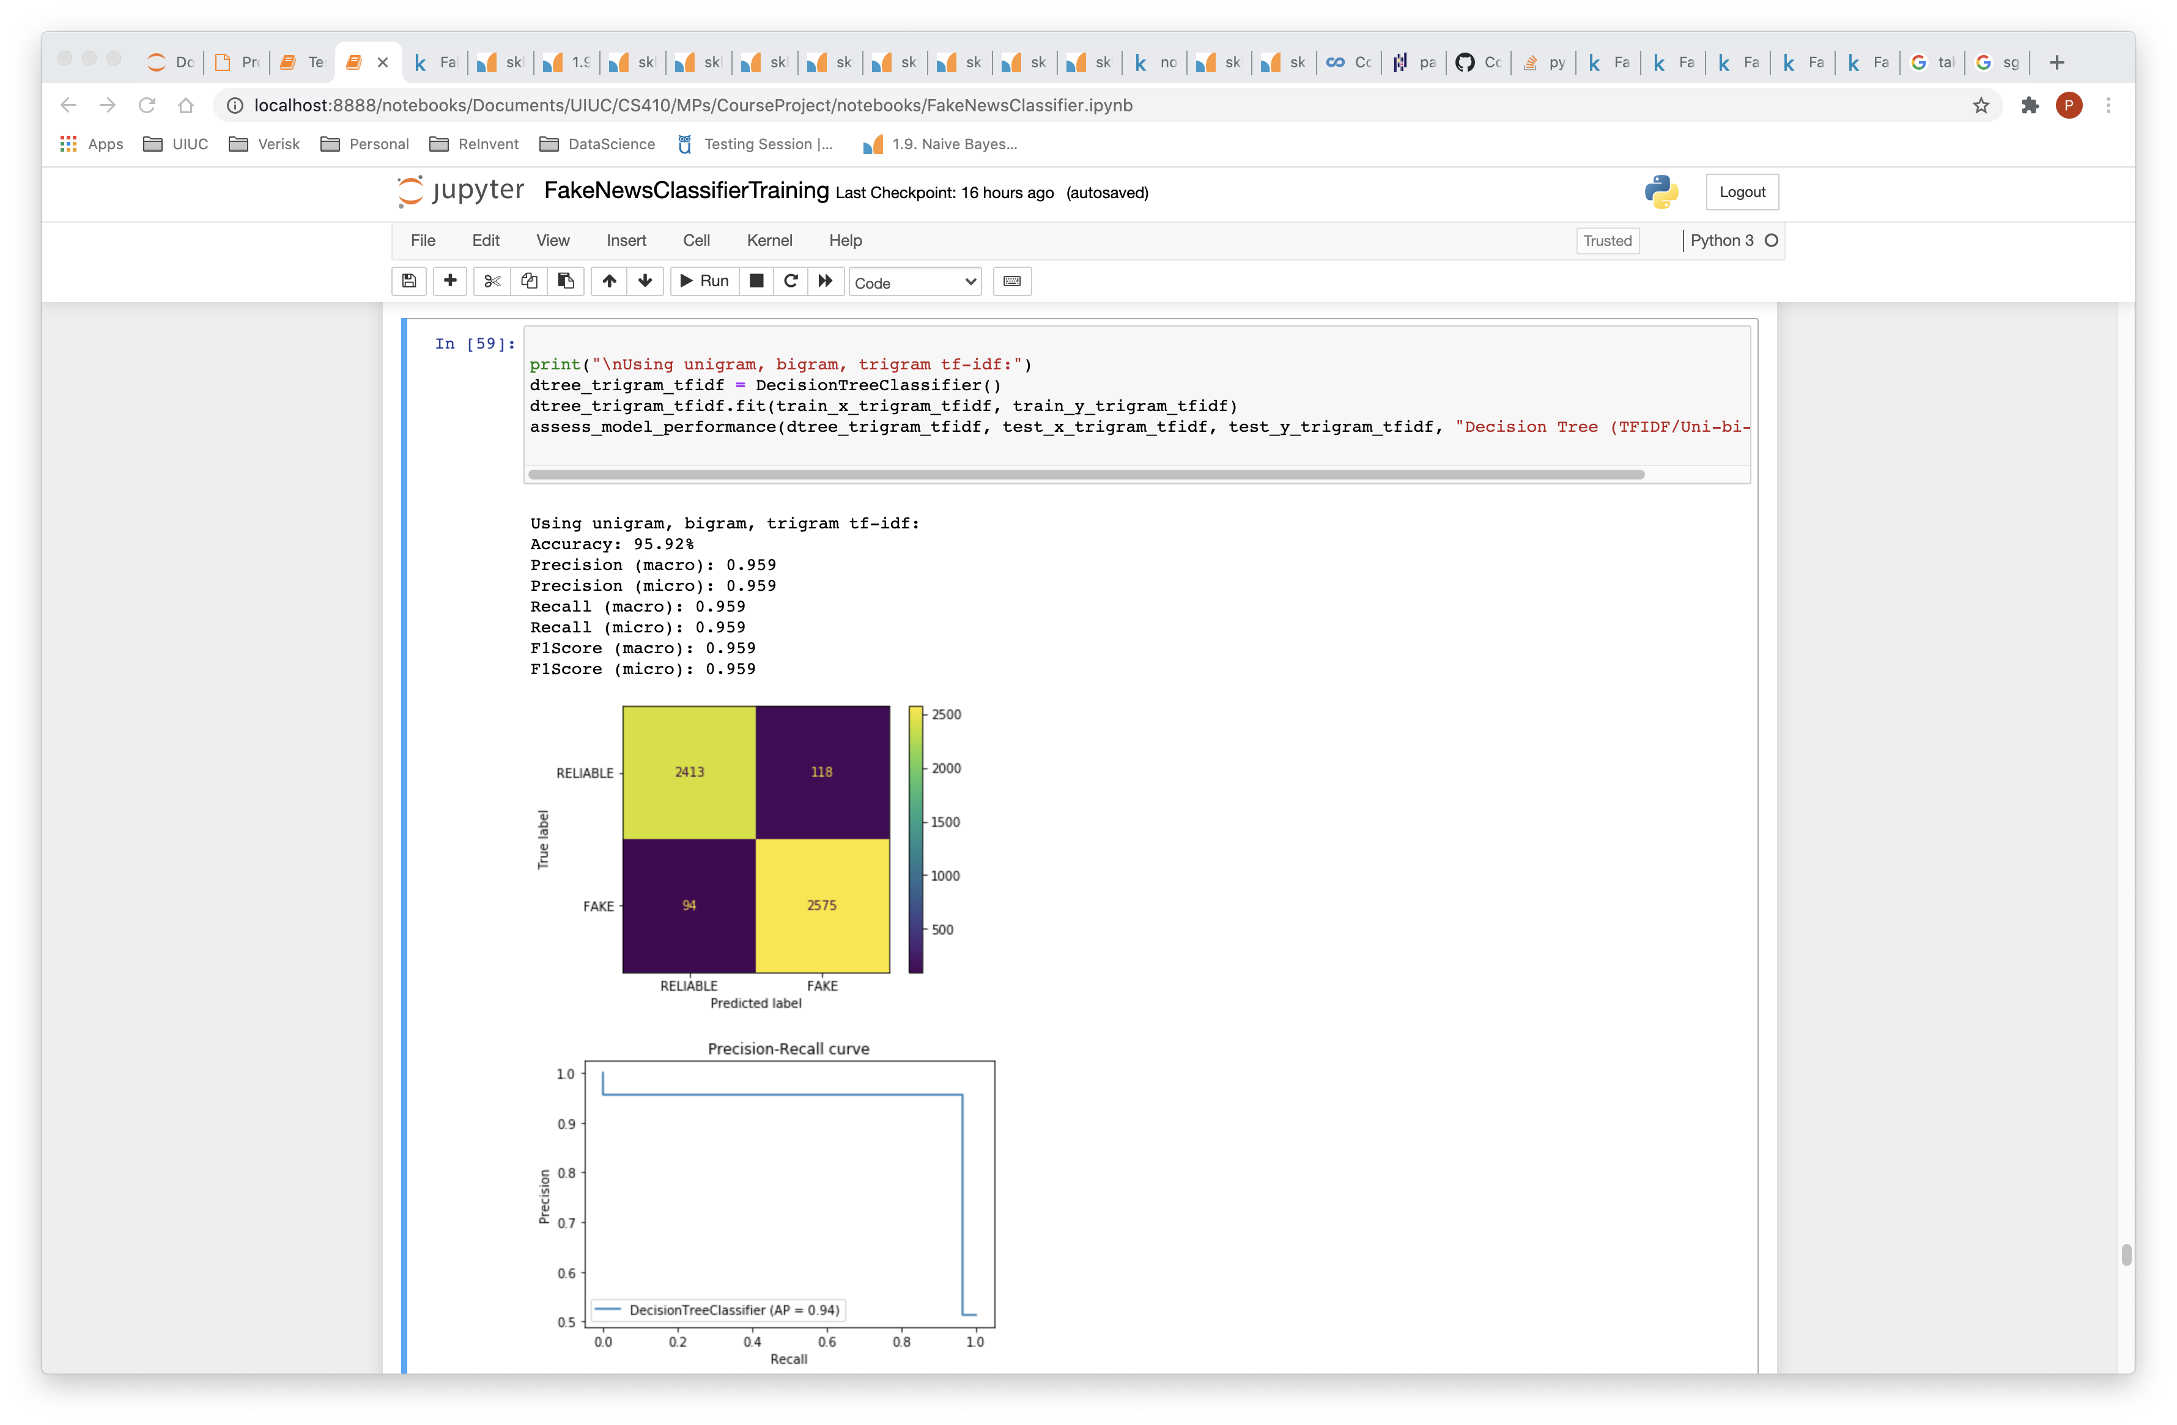

Slide 32
Performance Evaluation
Accuracy
Precision (macro/micro)
Recall (macro/micro)
F1 score
Confusion matrix
Precision-recall curve

Slide 33
 | accuracy | precision(macro) | precision(micro) | recall(macro) | recall(micro) | f1_score(macro) | f1_score(micro)
Decision Tree (TFIDF/Uni-bi-trigram) | 95.92% | 0.959 | 0.959 | 0.959 | 0.959 | 0.959 | 0.959
Decision Tree (TFIDF/Uni-bigram) | 95.60% | 0.956 | 0.956 | 0.956 | 0.956 | 0.956 | 0.956
Decision Tree (TFIDF/Unigram) | 92.81% | 0.928 | 0.928 | 0.928 | 0.928 | 0.928 | 0.928
Linear SVC (TFIDF/Uni-bi-trigram) | 95.87% | 0.959 | 0.959 | 0.959 | 0.959 | 0.959 | 0.959
Linear SVC (TFIDF/Uni-bigram) | 96.04% | 0.96 | 0.96 | 0.96 | 0.96 | 0.96 | 0.96
Linear SVC (TFIDF/Unigram) | 96.04% | 0.96 | 0.96 | 0.96 | 0.96 | 0.96 | 0.96
Linear SVC (TFIDF/Unigram/Regularization) | 87.27% | 0.873 | 0.873 | 0.873 | 0.873 | 0.873 | 0.873
Logistic Regression (TFIDF/Uni-bi-trigram) | 93.73% | 0.937 | 0.937 | 0.937 | 0.937 | 0.937 | 0.937
Logistic Regression (TFIDF/Uni-bigram) | 93.62% | 0.936 | 0.936 | 0.936 | 0.936 | 0.936 | 0.936
Logistic Regression (TFIDF/Unigram) | 94.27% | 0.943 | 0.943 | 0.943 | 0.943 | 0.943 | 0.943
Multinomial naive bayes (TF/Uni-bigram/Smoothing) | 92.44% | 0.931 | 0.924 | 0.923 | 0.924 | 0.924 | 0.924
Multinomial naive bayes (TF/Unigram/NoSmoothing) | 92.06% | 0.923 | 0.921 | 0.92 | 0.921 | 0.92 | 0.921
Multinomial naive bayes (TF/Unigram/Smoothing) | 89.75% | 0.907 | 0.897 | 0.897 | 0.897 | 0.897 | 0.897
Multinomial naive bayes (TFIDF/Uni-bi-trigram/Smoothing) | 75.46% | 0.831 | 0.755 | 0.761 | 0.755 | 0.742 | 0.755
Multinomial naive bayes (TFIDF/Uni-bigram/Smoothing) | 80.94% | 0.861 | 0.809 | 0.808 | 0.809 | 0.802 | 0.809
Multinomial naive bayes (TFIDF/Unigram/NoSmoothing) | 91.83% | 0.921 | 0.918 | 0.918 | 0.918 | 0.918 | 0.918
Multinomial naive bayes (TFIDF/Unigram/Smoothing) | 81.98% | 0.865 | 0.82 | 0.818 | 0.82 | 0.813 | 0.82
SGDC (TFIDF/Uni-bi-trigram) | 95.46% | 0.955 | 0.955 | 0.954 | 0.955 | 0.955 | 0.955
SGDC (TFIDF/Uni-bigram) | 95.65% | 0.957 | 0.957 | 0.957 | 0.957 | 0.957 | 0.957
SGDC (TFIDF/Unigram) | 95.56% | 0.956 | 0.956 | 0.956 | 0.956 | 0.956 | 0.956

Slide 34
Final Model
Linear SVC with unigrams TF-IDF vectorization
Export trained model using pipeline and joblib

Slide 35
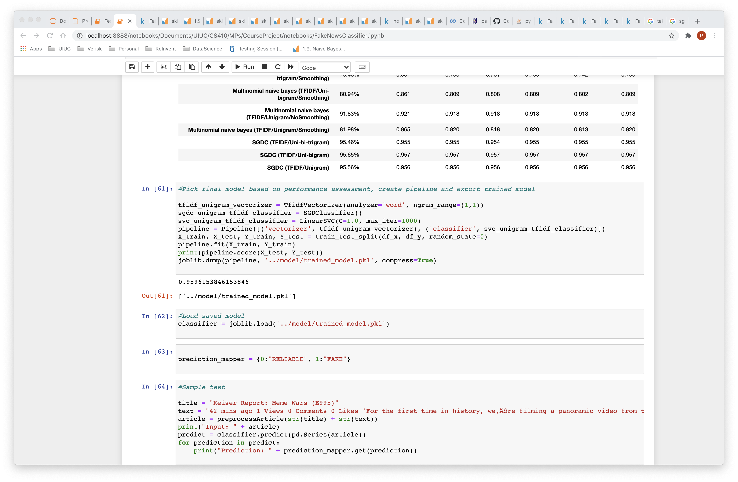

Slide 36
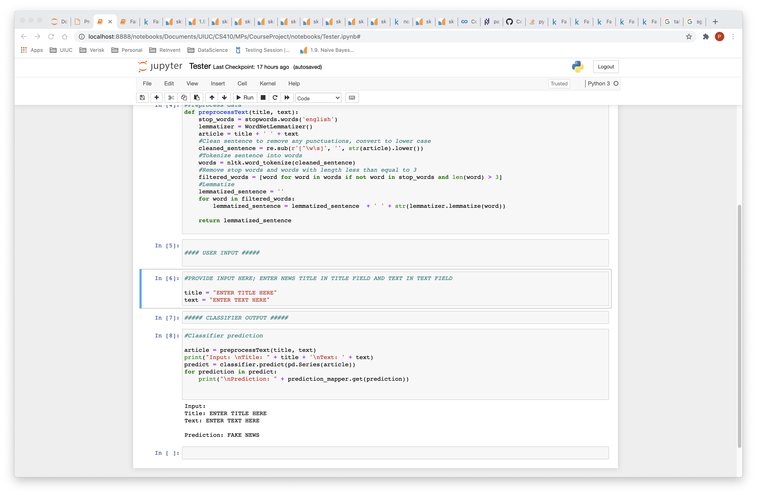
Tester
Tester.ipynb
Loads trained model using joblib
Add text and title as inputs in notebook

Slide 37
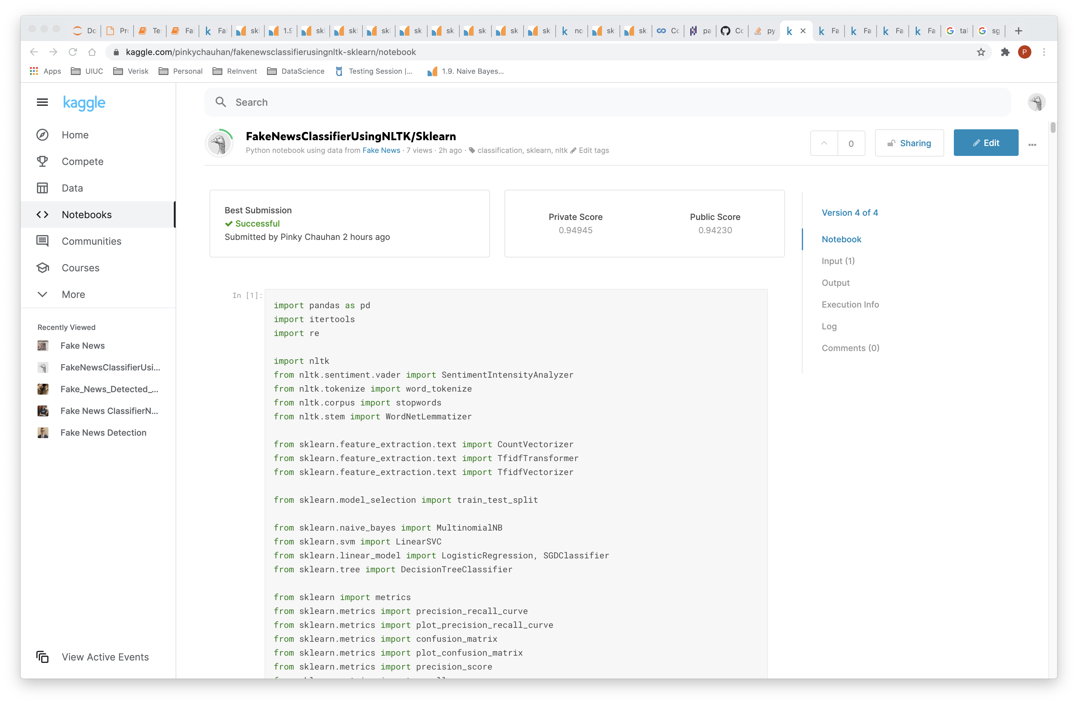
Kaggle
https://www.kaggle.com/pinkychauhan/fakenewsclassifierusingnltk-sklearn

Slide 38
References
https://www.kaggle.com/c/fake-news/data
https://scikit-learn.org/stable/user_guide.html
https://medium.com/datadriveninvestor/python-data-science-getting-started-tutorial-nltk-2d8842fedfdd
https://matplotlib.org/tutorials/introductory/pyplot.html
https://towardsdatascience.com/machine-learning-classifiers-a5cc4e1b0623

